Slide 1
Miku AI Assistant
An Offline, Multilingual (English · Hindi · Hinglish) Voice Assistant
.

Slide 2
OVERVIEW
What We'll Cover
1
Introduction & Problem Statement
2
Objectives & Key Design Decisions
3
System Architecture & Tech Stack
4
Module Deep-Dive: Frontend, Backend, LLM, STT, TTS
5
End-to-End Data Flow & Live Demo
6
Challenges, Results, Future Work
Miku AI Assistant
1

Slide 3
INTRODUCTION
What is Miku?
100%
Miku is a fully offline AI voice assistant.
Built for users who want privacy-first AI without cloud APIs.
Supports Hindi, English, and Hinglish (Roman Hindi) conversations.
Uses voice input & output — speak naturally, get spoken replies.
Runs entirely on a local machine using open-source models
Offline Processing
3
Languages Supported
Real-time
Streamed Replies
Miku AI Assistant
2

Slide 4
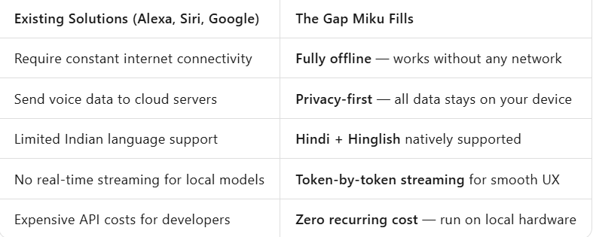
MOTIVATION
Problem Statement
3
.
Miku AI Assistant
3

Slide 5
GOALS
Objectives
1
Fully offline AI chat powered by a local LLM (no cloud dependency)
2
Voice input (speech-to-text) and voice output (text-to-speech)
3
Multilingual support: English, Hindi (Devanagari) and Hinglish (Roman → Devanagari)
4
Real-time token-by-token streaming of replies for a responsive feel
5
Persistent chat memory so conversations stay contextual
Miku AI Assistant
4

Slide 6
DESIGN
Key Design Decisions
Local LLM Server
Runs the AI model locally and provides responses to the application..
HTTP Token Streaming
LLM tokens are streamed to the browser over a plain HTTP streaming response , giving a live 'typing' effect without extra infrastructure.
Hinglish-Aware TTS
Romanized Hinglish text is converted to Devanagari with a phoneme-aware fallback before speech synthesis, for far more natural pronunciation.
Miku AI Assistant
5

Slide 7
MODULE · LLM
Local LLM via llama.cpp
What is llama.cpp?
An open-source tool that runs AI language models locally on your computer without using the internet.
How it works in this project
The Flask backend sends user requests to the local llama.cpp server, which generates responses and sends them back to the application.
client = OpenAI(
base_url="http://127.0.0.1:8080/v1",
api_key="dummy"
)
System prompt (prompts.txt) defines Miku's personality & instructions.
temperature = 0.2 · max_tokens = 80
focused, concise replies
Miku AI Assistant
12

Slide 8
TECHNOLOGY
Tech Stack
F
l
f
Flask
llama.cpp
faster-whisper
Backend API & streaming endpoints
Local LLM server, OpenAI-compatible
On-device speech-to-text
P
i
H
Piper TTS
indic_transliteration
HTML / CSS / JS
Hindi & English voice synthesis
ITRANS → Devanagari conversion
Chat UI, recording, streaming client
Miku AI Assistant
7

Slide 9
ARCHITECTURE
System Architecture
Browser Frontend
HTML · CSS · JS
Flask Backend
/chat-stream · /speak · /transcribe · /history
Local On-Device Services
l
f
P
llama.cpp
faster-whisper
Piper TTS
LLM — streaming replies
Speech-to-Text
Text-to-Speech
All three services run entirely on-device — no data ever leaves the machine.
Miku AI Assistant
6

Slide 10
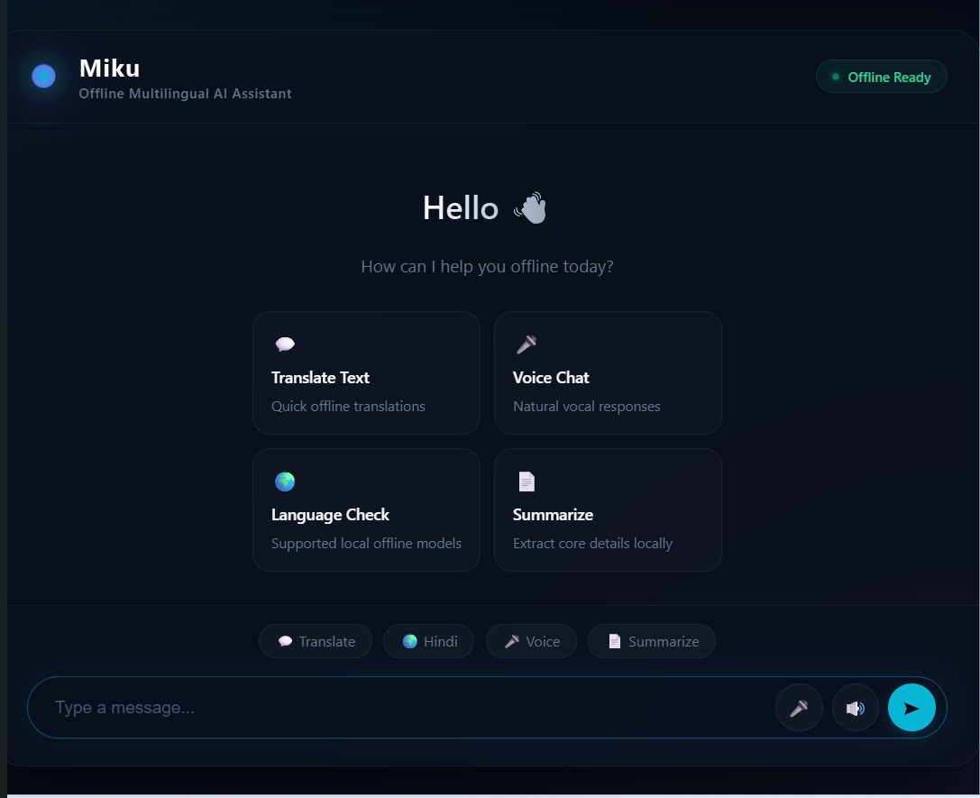
MODULE · FRONTEND
UI Walkthrough
Chat Bubbles
Text + voice entry with a live typing indicator while tokens stream in.
Voice Overlay
[ Screenshot: Chat Interface ]
A dedicated recording overlay with mic button and ripple animation.
Theme Toggle
Switch between dark and light glassmorphism themes instantly.
Miku AI Assistant
8

Slide 11
MODULE · BACKEND
How Chat Streaming Works
1
llama.cpp generates the reply one token at a time
2
A Python generator (yield) forwards each token immediately
3
Flask returns a streaming Response (mimetype text/plain)
4
The browser reads the stream with the Fetch Reader API
5
Each chunk is appended to the chat bubble live
Note: this is plain HTTP streaming (Flask generator + Fetch Reader) — not SSE or WebSockets.
Miku AI Assistant
11

Slide 12
MODULE · BACKEND
Flask Routes
Accepts a user message, streams LLM reply tokens back to the client, appends to chat memory.
/chat-stream
Converts finished text into speech audio via Piper and returns a playable audio URL.
/speak
Receives recorded PCM audio, runs it through faster-whisper, returns the transcribed text.
/transcribe
Reads and returns the saved chat session (JSON) for the history panel.
/history
Miku AI Assistant
10

Slide 13
MODULE · LLM
Context & Chat Memory
chat_history.json
MAX_HISTORY_MESSAGES = 20
Every user + assistant message pair is appended to a JSON file on disk — so memory survives server restarts.
Only the last 20 messages (10 exchanges) are sent back to the LLM as context on every new request — keeping replies coherent without an unbounded prompt.
[
{"role":"user","content":"..."},
{"role":"assistant","content":"..."}
]
messages = [system_prompt]
+ chat_history[-20:]
+ [new_user_message]
Miku AI Assistant
13

Slide 14
MODULE · TTS
Text-to-Speech with Piper
Piper is a fast, fully offline TTS engine that uses lightweight ONNX voice models to synthesize natural-sounding speech.
🔊
🔊
🔊
🔊
hi_IN-priyamvada-medium.onnx
en_GB-alba-medium.onnx
Hindi voice model — used for Hindi & Hinglish (post-conversion) text
English voice model — used for plain English replies
Miku AI Assistant
16

Slide 15
MODULE · FRONTEND
Voice Recording Pipeline
1
2
3
4
5
Mic Input
AudioContext
Downsample
16-bit PCM ( Pulse Code Modulation)
POST /transcribe
getUserMedia() captures raw microphone audio in the browser.
A ScriptProcessorNode reads live audio samples as they arrive.
Samples are downsampled to exactly 16kHz — Whisper's required rate.
Float32 samples are converted to 16-bit PCM before sending.
Raw PCM bytes are sent to Flask for on-device transcription.
Why this matters: sending audio in the wrong sample rate / format is the #1 cause of garbled transcriptions.
Miku AI Assistant
9

Slide 16
MODULE · STT
Speech-to-Text Pipeline
Browser Mic
16kHz PCM Audio
faster-whisper
(Whisper 'small', CPU, int8)
Auto Language
Detection
Transcribed Text
faster-whisper is an optimized implementation of OpenAI's Whisper model. The 'small' model with int8 quantization gives a good balance of accuracy and speed on CPU, with no GPU required.
Miku AI Assistant
14

Slide 17
MODULE · TTS
Hinglish → Devanagari (Example)
Input (Roman)
Detect Hinglish
Normalize + Transliterate
Output (Devanagari)
"kaise ho aap"
is_hinglish() finds known Hindi-in-Roman words
ITRANS → Devanagari conversion
"कैसे हो आप"
Result: the Hindi voice model pronounces this naturally — instead of an English engine mangling Romanized Hindi text.
Miku AI Assistant
17

Slide 18
MODULE · TTS
Fallback for Unknown Words
What happens if a word isn't in the dictionary?
Example mapping
K
AA
S
T
1
Look up the word's phonemes using the pronouncing library (CMU Pronouncing Dictionary)
क
आ
स
ट
2
Map each phoneme to Devanagari consonant/vowel characters using custom mapping tables
Consonant table (CONSONANTS) + vowel table (VOWELS) drive this letter-by-letter reconstruction — entirely custom logic written for this project.
3
Build the final Devanagari spelling letter-by-letter
4
Log the word to unknown_words.log for future dictionary improvement
Miku AI Assistant
18

Slide 19
DATA FLOW
End-to-End Flow
Text Chat
User types
LLM streams reply
Bubble updates live
Piper speaks reply
Voice Chat
User speaks
Audio → 16kHz PCM
Whisper transcribes
→ joins text-chat flow
Design goal: minimize latency and keep every processing step fully local — nothing ever leaves the device.
Miku AI Assistant
19

Slide 20
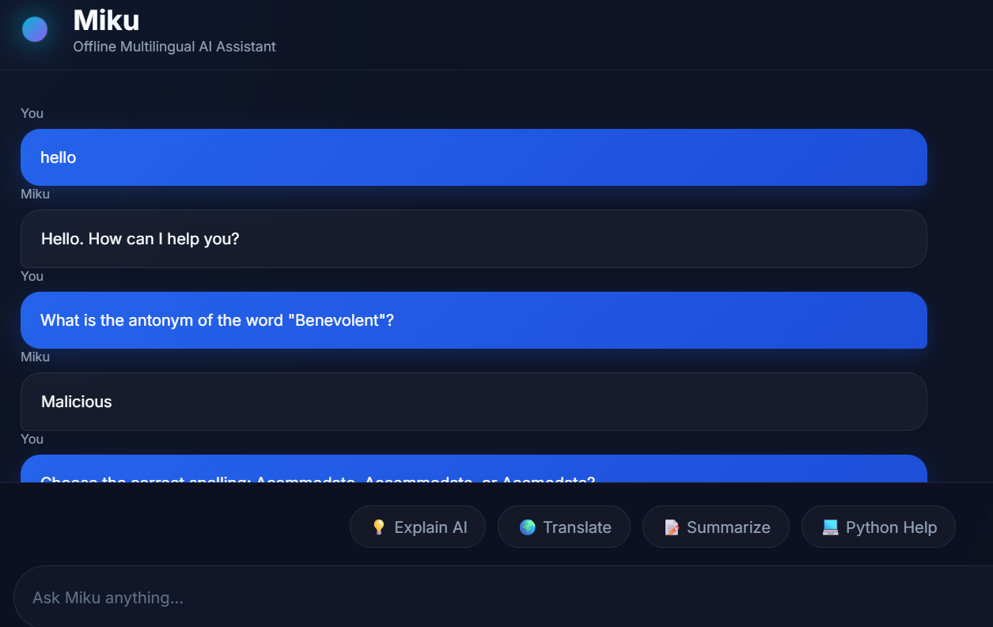
DEMO
Screenshots of chats
Miku AI Assistant
20

Slide 21
REFLECTION
Challenges Faced
!
!
!
Audio Format Matching
Streaming Responses
Hinglish Pronunciation
Whisper requires a precise sample rate & PCM format — browser audio needed reliable resampling to 16kHz to avoid transcription errors.
Coordinating token-by-token LLM output with the frontend's live display required careful buffering in the Flask generator.
Romanized Hindi spelling is inconsistent — built a phoneme-aware fallback to translate ambiguous inputs into Devanagari.
Miku AI Assistant
21

Slide 22
OUTCOMES
Results — What Works Well
✓
Handles English, Hindi, and Hinglish input reliably end-to-end
✓
Chat replies stream live with no perceptible lag on typical text lengths
✓
Hinglish text is converted and spoken with noticeably improved pronunciation
Chat memory persists correctly across app restarts (JSON-backed)
✓
Fully functional without any internet connection
Miku AI Assistant
22

Slide 23
WHAT'S NEXT
Future Work
1
More Languages
2
Database Storage
Expand beyond Hindi/English to Bengali, Tamil, and other Indian languages with dialect-aware accents.
Replace the JSON history file with SQLite/Postgres for efficient, searchable chat storage.
3
Progressive TTS
4
Mobile Client
Stream speech synthesis so playback can begin before the full reply finishes generating.
Build an Android/iOS app with embedded or companion local model execution.
Miku AI Assistant
23

Slide 24
Thank You
Miku AI Assistant
24

Slide 25
Miku AI Assistant
15

